Slide 1
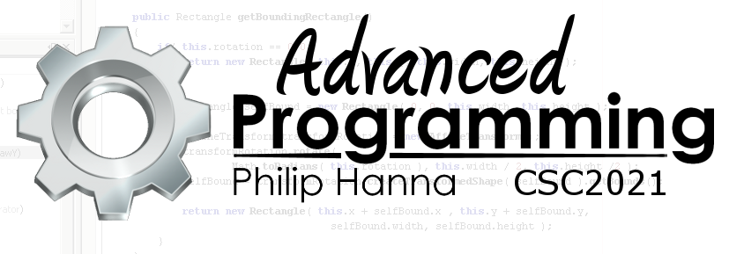
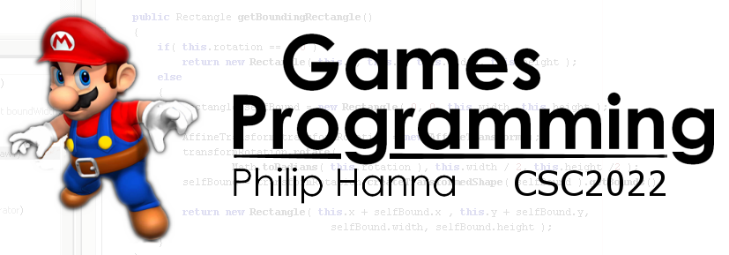
Game Loop
Evolving and rendering game objects

Slide 2
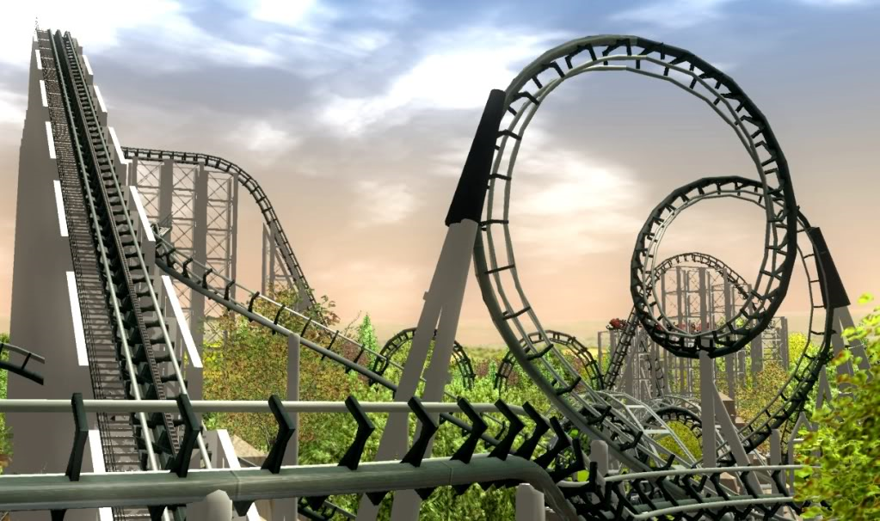
The Game Loop

Slide 3
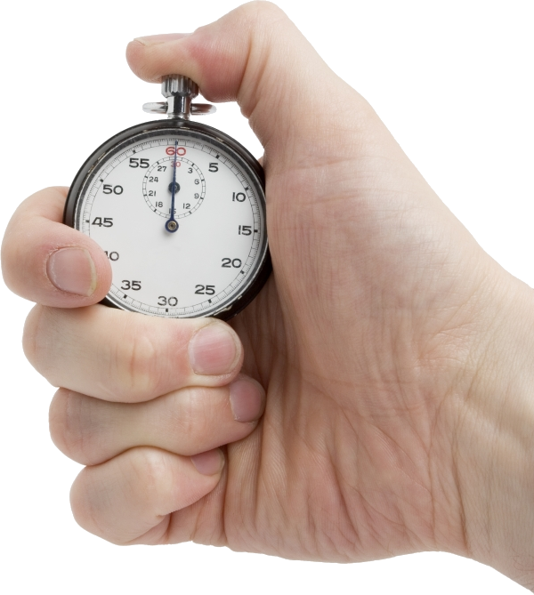
Games require a timer to manage the game loop.
Early games used the machine as the timer
the update/render loop would run as fast as possible (tied to processor speed)
used as typically no spare CPU resource and common platform hardware
However, the approach does not scale to varied platforms or increased hardware capabilities

Slide 4
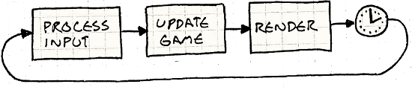
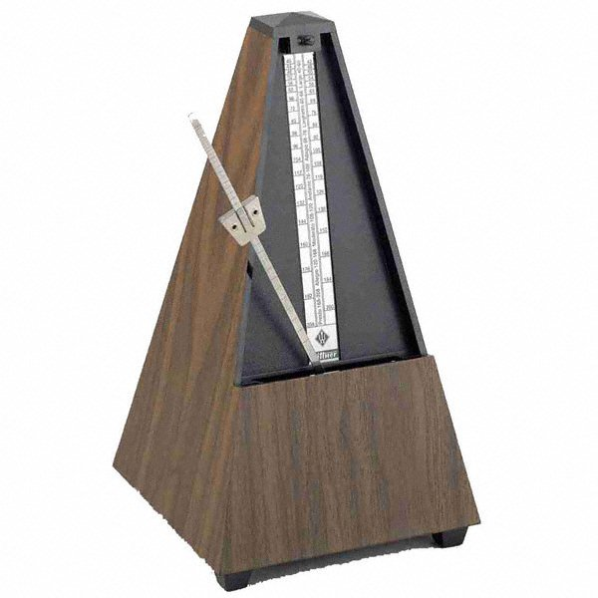
Tying things together… an early solution was to use a fixed frame rate as the timer (with one update/render tick every frame)
Why is this problematic?
● UPS reduced if update and draw take too long
● game runs slower, not just displayed with lower FPS

Slide 5

Start
10 mins
9 mins
8 mins
7 mins
6 mins
5 mins
4 mins
3 mins
2 mins
1 min
30 sec
Finished
Breaking things together… Assume you have access to the following methods:
● update() – update all game objects
● render() – draw all game objects
● time() – get the current time (ms)
● sleep(x) – sleep for x ms
Develop an approach that attempts to provide a target number of updates per second (ups), reducing the renders per second (fps) if needed to hit the ups target.

Slide 6
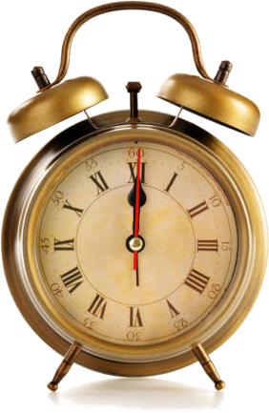
A game loop will request that its thread goes to sleep if the update and render has been completed within the target period.
On current hardware sleep requests are not accurate to the millisecond.
Overtime this inaccuracy can add up to lost frames.

Slide 7
updatePeriod = 1000 / UPS
timeBeyondPeriod = 0
overTime = 0
Loop 1 Loop 2
1 | while (running) {
2 | tBefore = time();
3 | update();
4 | render();
5 | tAfter = time();
6
7 | sleepTime = updatePeriod - (tAfter - tBefore) – overtime;
8
9 | if (sleepTime > 0) {
10 | sleep( sleepTime);
11 | overTime = time() - tAfter – sleepTime;
12 | }
13 | else {
14 | timeBeyondPeriod = timeBeyondPeriod – sleepTime;
15 | overTime = 0;
16 | while (timeBeyondPeriod > updatePeriod ) {
17 | update();
18 | timeBeyondPeriod = - updatePeriod;
19 | }
20 | } }
u
Period
r
s
o
Loop n Loop m
Period

Slide 8
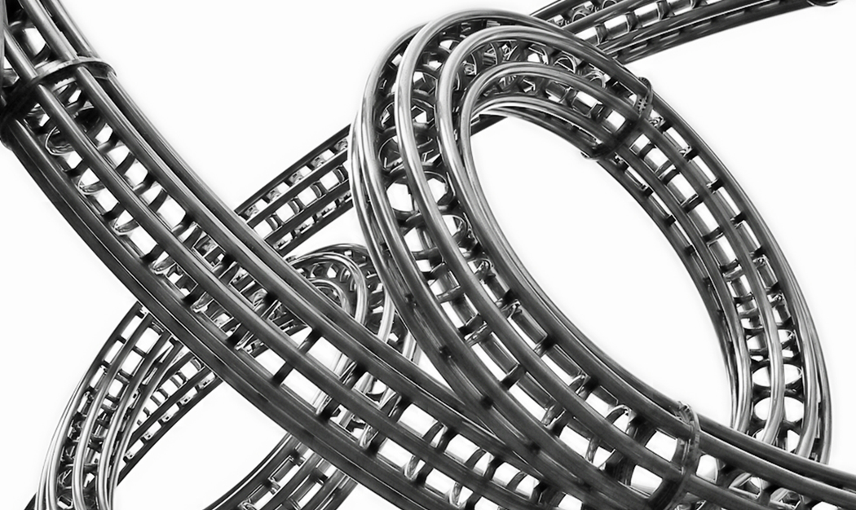
More Advanced Looping

Slide 9

Variable Steps
The update and render steps are run as fast as possible.
The elapsed time (delta step value) is passed to each update and render call.
More ticks with a smaller delta value occur on a faster machine.
Fewer ticks with a larger delta value occur on a slower machine.

Slide 10

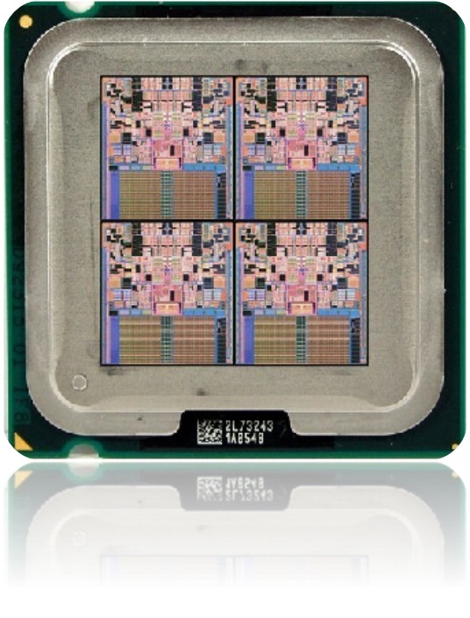
Multi-threading
Modern hardware typically includes multi-core CPUs and specialised GPUs.
Maximum efficiency arises when the update and rendering phases are decoupled (as much as possible) and run in parallel.
Render World (t)
Prepare Update (t+1)
Update world (t+1)

Slide 11

When designing game objects decouple the update and render behaviours. Ask two separate questions: ‘how will I update this’ and ‘how will I draw this’
e.g. for an animation, select the animation to be display in the update phase and render it in the draw phase
The draw phase should not change the game state (i.e. properties, etc. of objects, it should simply visualise the game state)

Slide 12

Key takeaways:
Getting a smooth UPS is a bit fiddly but generally possible.
To be fully effectively, the game loop needs to be designed to support multi-threading.
When designing game objects decouple update and render behaviours.

